Slide 1


Welcome to
SHIBAURA
INSTITUTE
OF TECHNOLOGY
Tokyo, Japan
Learn from the world, contribute to the world

Slide 2
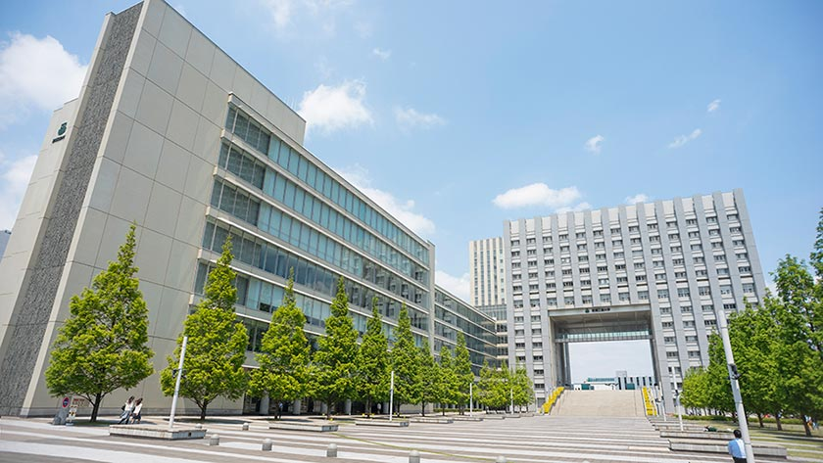
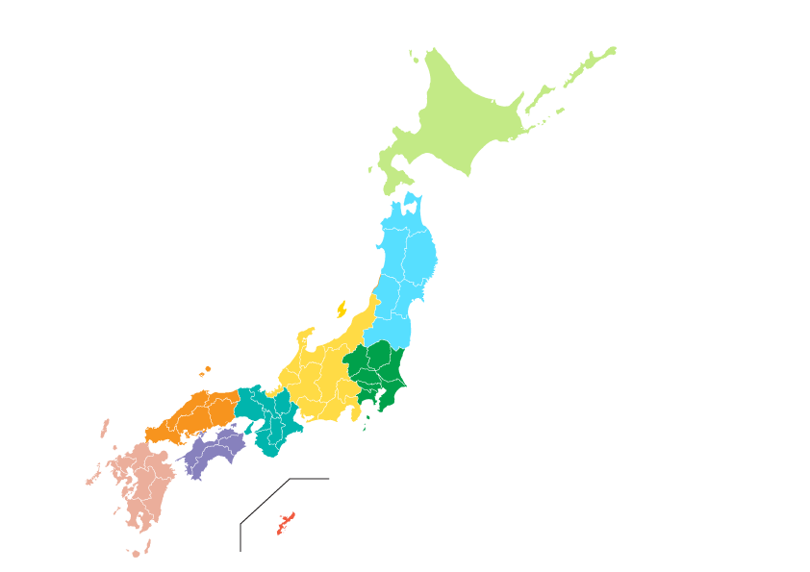
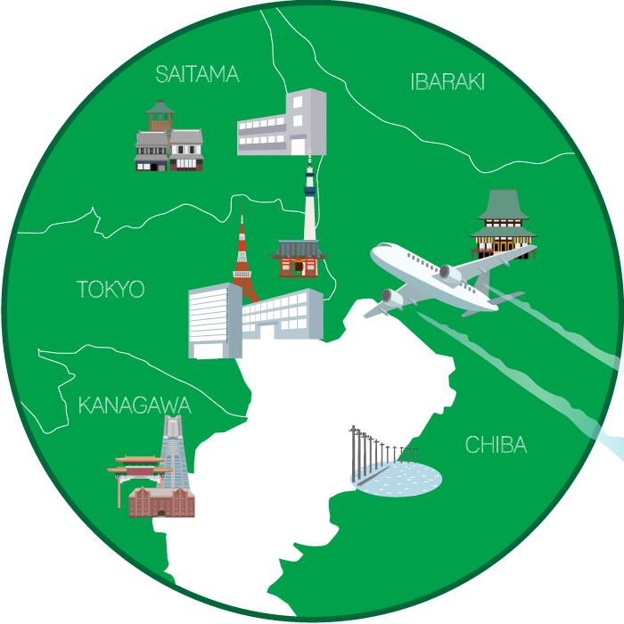
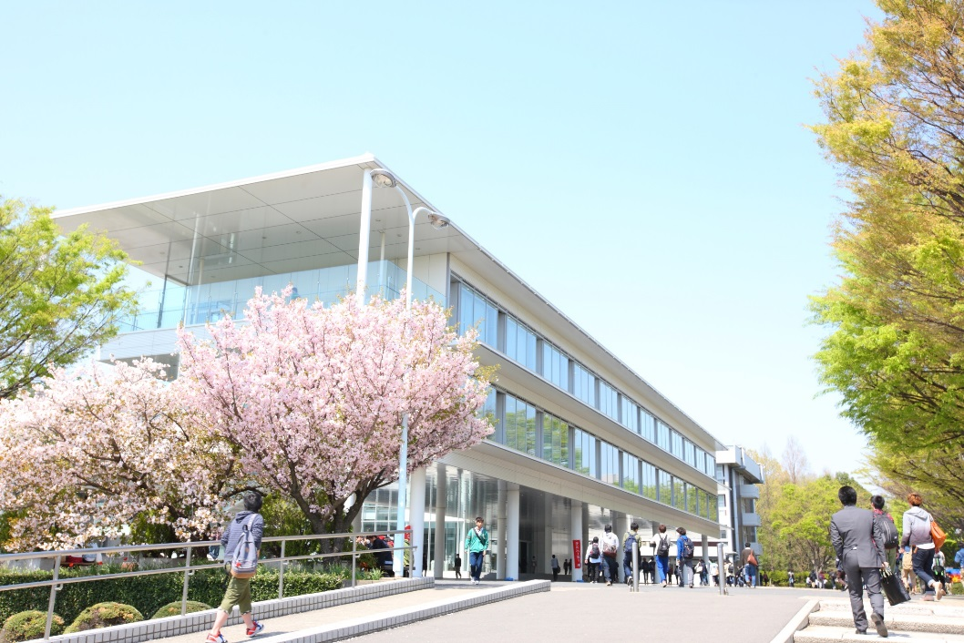
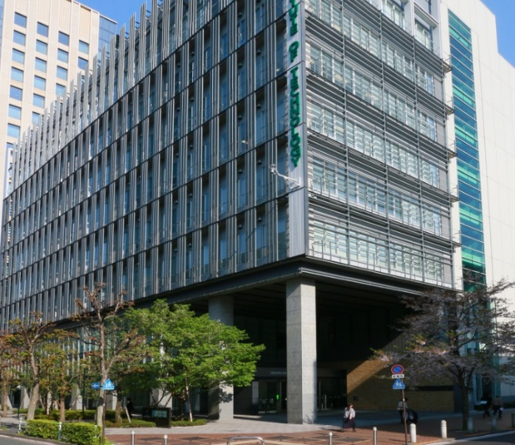
Campus Location
Toyosu Campus
３
CAMPUS
Locations in
Tokyo Area
Omiya Campus
Shibaura
campus

Slide 3
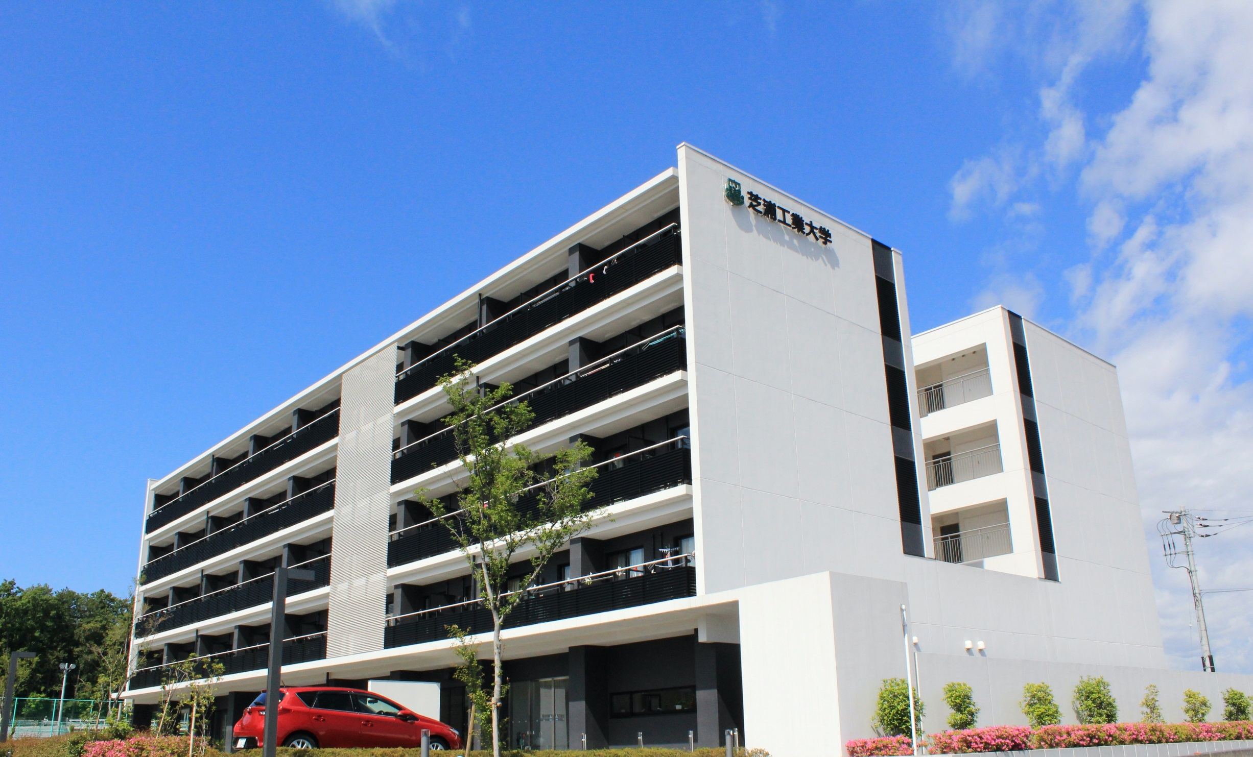
This dormitory for International students and Japanese students
Five story concrete building
122 rooms
SIT Global Dormitory

Slide 4

9,089
Total Enrollment
AY2020-2021
4,255
997
2,092
665
1,080
College of Engineering
School of Architecture
College of Systems Engineering and Science College of Engineering and Design
Graduate School
Undergraduates 8,009
Graduates 1,080
3
Notes:
As of June 17,2020

Slide 5
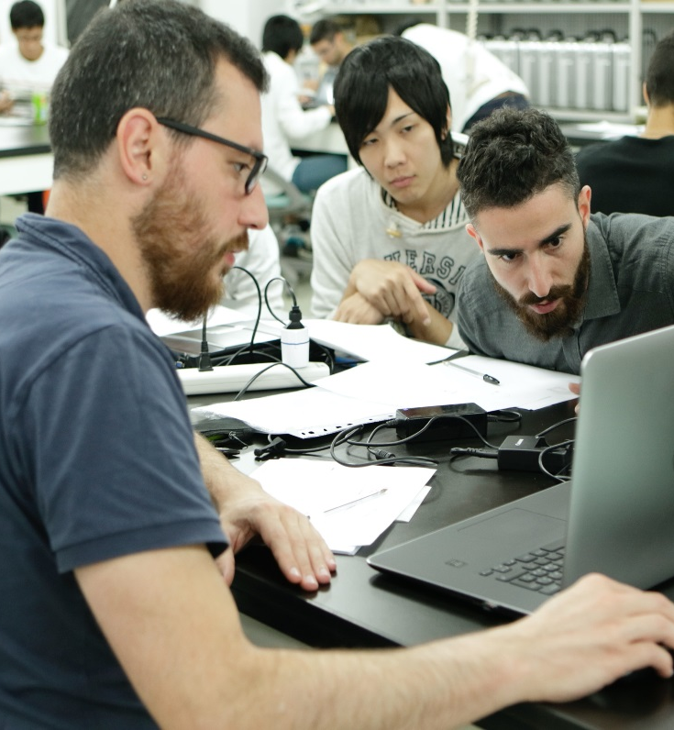
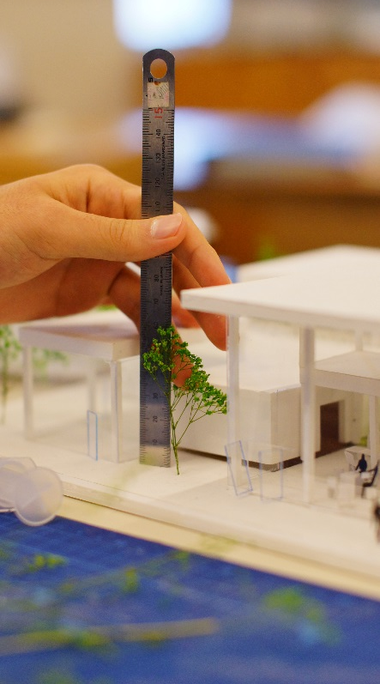
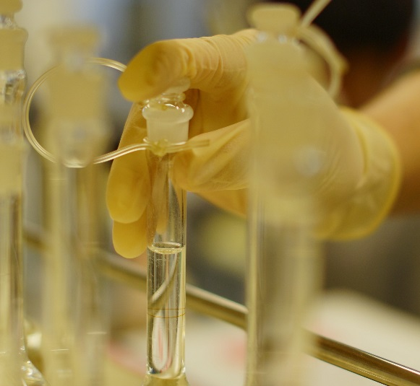
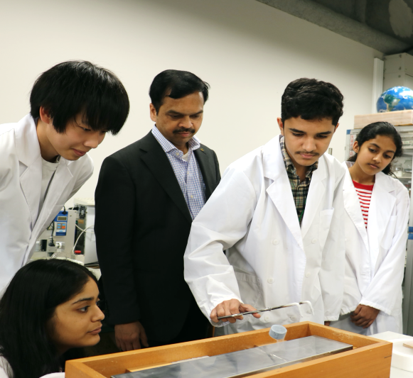
STUDY FIELDS
16 Departments
in 3 Colleges and 1 School
&
1 Graduate School
Your Future Starts Here
4
Notes:
工学だけではなく、理学の分野にも積極的に手を広げています。

Slide 6
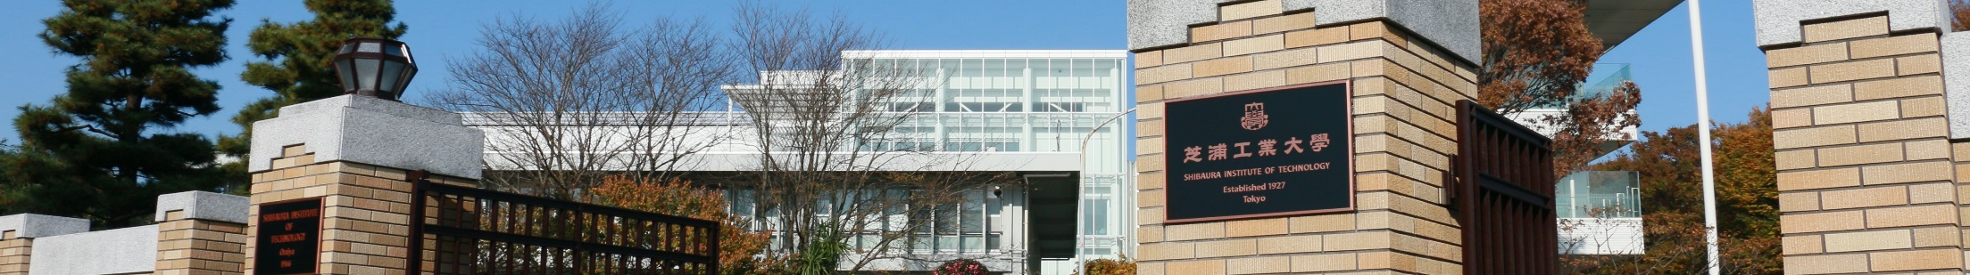




Undergraduate Program
※4 years- Japanese Based Programs
Mechanical Engineering
Engineering Science and Mechanics
Materials Science and Engineering
Applied Chemistry
Electrical Engineering
Electronic Engineering
Information and Communications
Engineering
Computer Science and Engineering
Civil Engineering
Electronic Information Systems
Machinery and Control Systems
Planning, Architecture and
Environmental Systems
Bioscience and Engineering (2 Courses)
Mathematical Sciences
Engineering
Systems Engineering and Science
9 Dept.
5 Dept.
Engineering and Design
Engineering & Design (2 Fields)
1 Dept.
Architecture
Architecture（3 Courses）
1 Dept.
5
Notes:
工学だけではなく、理学の分野にも積極的に手を広げています。

Slide 7
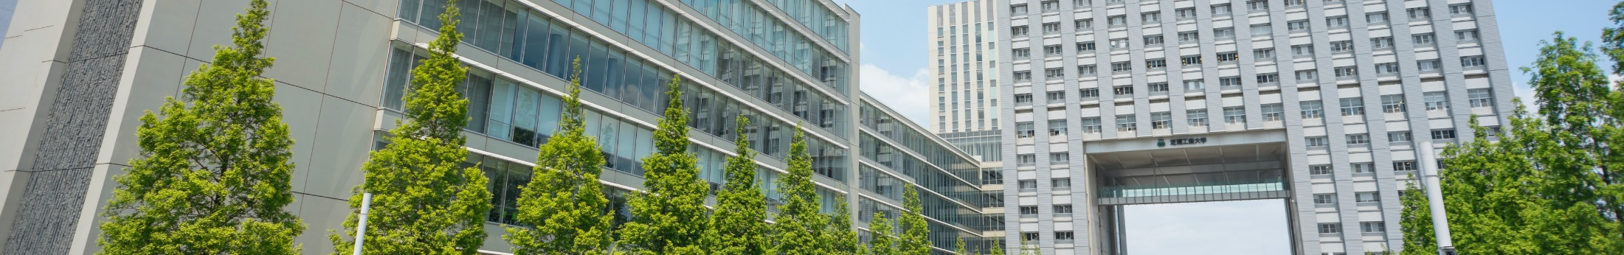

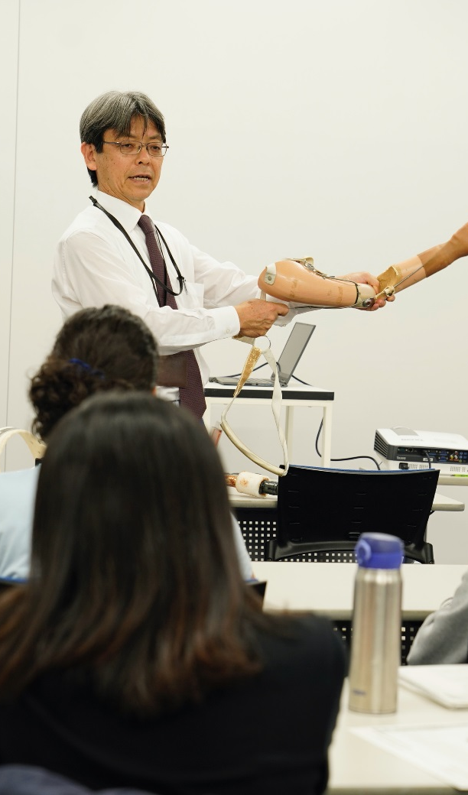

Graduate Program
Master's Programs (2years)
Doctoral Programs
(3 Years)
Electrical Engineering
and Computer Science
Materials Science and Engineering
Applied Chemistry
Mechanical Engineering
Architecture and Civil Engineering
Systems Engineering and Science
Global Course of Engineering
and Science
7 Programs
2 Programs
Regional Environment Systems
Functional Control Systems
The Graduate School comprises fields of study from undergraduate programs.
6
Notes:
工学だけではなく、理学の分野にも積極的に手を広げています。

Slide 8





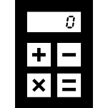

SIT Lab
Electrical/Electronic/Information
Materials/
Applied Chemistry
Architecture/
Civil Engineering
7 Major Academic
Field
7 MAJOR
ACADEMIC
FIELDS
Mechanical
Design
Mathematical
Sciences
Biotechnology

Slide 9

New Program for Undergraduate
8
Notes:
工学だけではなく、理学の分野にも積極的に手を広げています。

Slide 10



9
Notes:
工学だけではなく、理学の分野にも積極的に手を広げています。

Slide 11


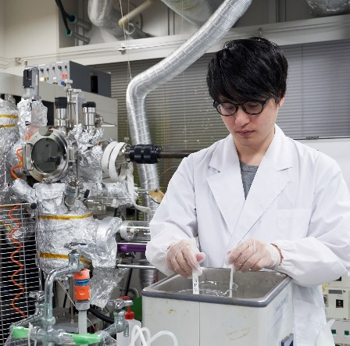
Top Global University
Project
RANKED
Government chose 37 UNIVERSITIES
to be role models for the globalization of Japanese educational institutions.
#1001+
THE World University
Ranking 2021
#35
SIT is the ONLY university in private science and engineering universities in Japan to receive federal funds for this project.
THE JAPAN University
Ranking 2020
#8
THE JAPAN University
Ranking 2020
(Private University)
10
Notes:
About 800 univ in japan.
In 2014, the Japanese government announced that it will provide subsidies for 37 universities under the Top global university project to act as role models for globalization of Japanese educational institutions. The project’s goals are to enhance Japanese universities’ international competitiveness and develop global-minded human resources. SIT was among the selected universities.

Slide 12
















Total Number of
International Students
2019
1,692
Number of International Students (Top 15)
503
China
212
Thailand
South Korea
144
Malaysia
130
Taiwan
104
Indonesia
90
Brazil
79
Vietnam
66
Total Number of
International Students
2019
India
58
Sri Lanka
33
31
1,692
Mexico
Italy
28
France
25
25
Poland
Austria
16
Notes:
Based on stats of may 1, 2017

Slide 13
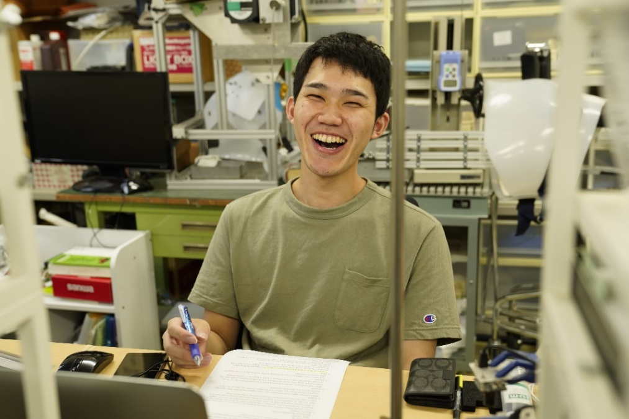
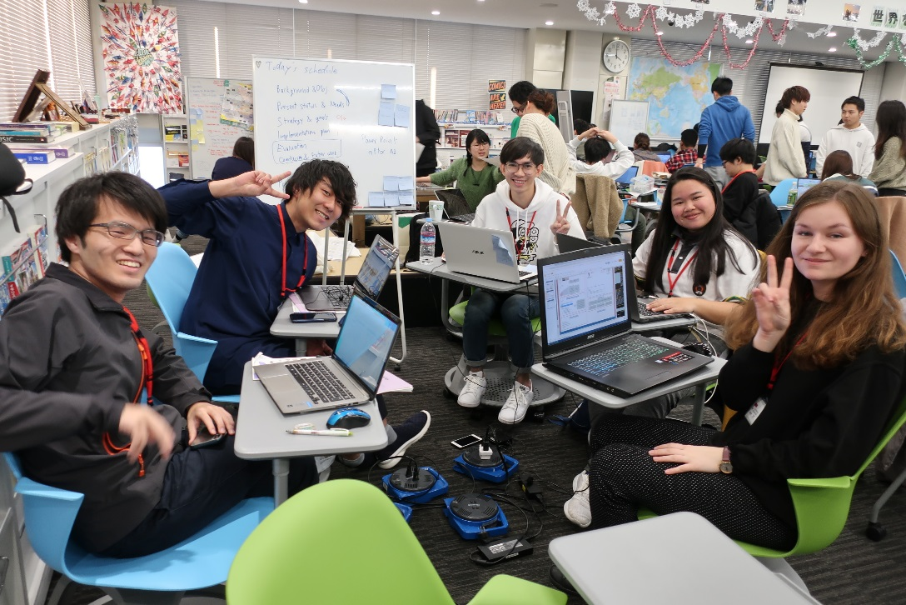

Mobility Programs
INTERNATIONAL
PROGRAMS
(Non-Degree Seeking)
gPBL
(Global Project Based Learning )
Program
Sandwich
Program
for Undergraduate
Research Exchange/Laboratory Internship Program
for
Graduate ＆Undergraduate
12

Slide 14
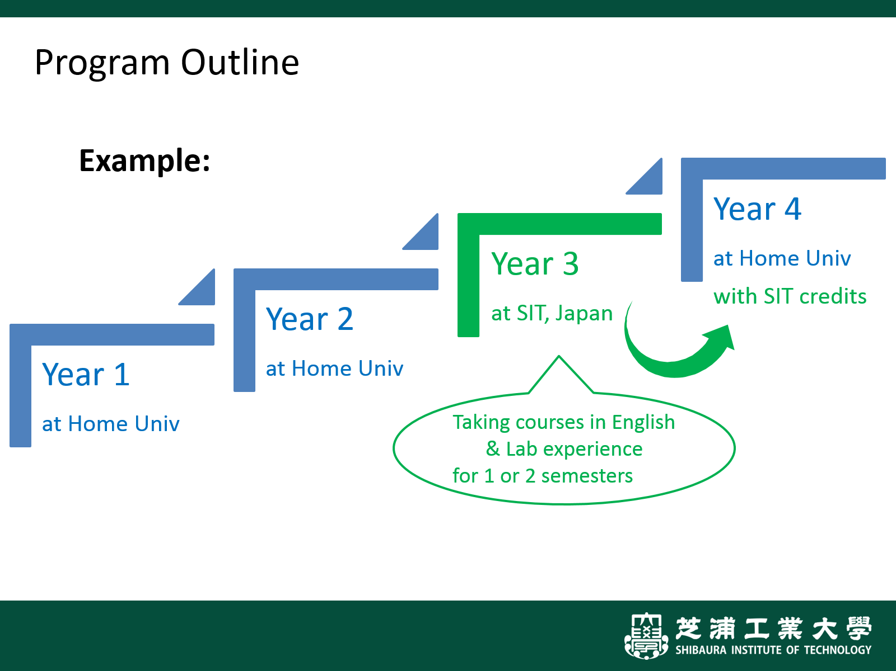
Sandwich Program
Overview

Slide 15
Sandwich Program
Program Outline
Content | Taking courses taught in English
Application | Deadline： April 30th for Fall Semester 2020 (Mid Sept. - Jan.) October 30th for Spring Semester 2021 (Early Apr. - Aug.)
Duration | 1 or 2 Semesters (half a year or whole year)
Tuition | Admission : JPY40,000 Tuition : JPY12,000 per credit Registration fee : JPY30,000 *The admission fees and tuition are waived for Partner University Students
Scholarship | JPY40,000(max) per month during the program for qualified students
Eligibility | Undergraduate and Graduate students of partner universities Good English skill - CEFR B2 or equivalent

Slide 16
Research Exchange/Laboratory Internship Program
This program is for international students who wish to conduct a research activity under a designated supervisor at SIT.
Program Outline
Content | Research activity
Application | Deadline : 6 months before your arrival
Duration | 8 working days - 1 year
Tuition | Admission fee : JPY40,000 Tuition : JPY12,000 / credit (if you take courses) Registration fee : JPY30,000 *The admission fees and tuition waived for Partner University Students
Scholarship | JPY40,000(max) per month during the program for qualified students
Eligibility | Higher than 3rd year Undergraduate or graduate students

Slide 17
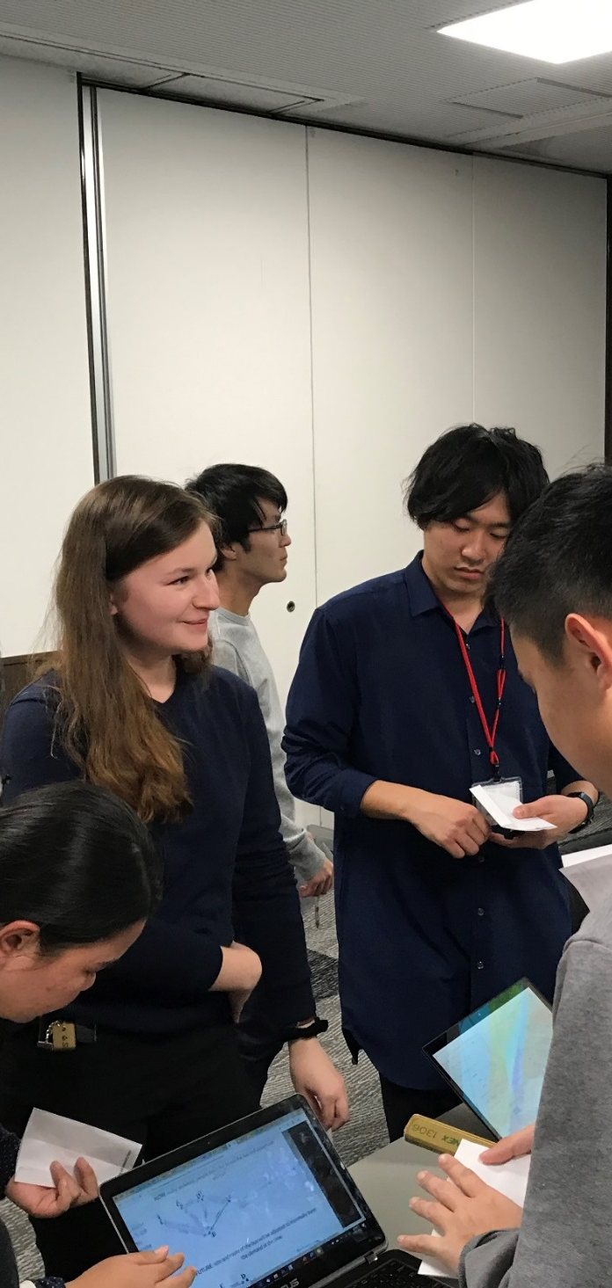


Global
Project
Based
Learning
(gPBL)
BENEFITS
Solve the challenging real-world issues
Gain hands-on project experience
Network with other students and companies
Enhance teamwork, communication, presentation, critical thinking, and problem solving skills
Students from overseas working as tag teams will discuss and solve problems challenging issues related to their major.
Scholarship Opportunity
JASSO Scholarship is available for
qualified students and based on GPA.
Team members bring their knowledge and skills together to develop innovative solutions within a short time frame (approx. two weeks to one month).
Intensive Program
at one of the
TOP PRIVATE
Science and Engineering University
The Total Number of gPBL in AY2019
81
gPBL
(36 in Japan, 45 overseas)

Slide 18
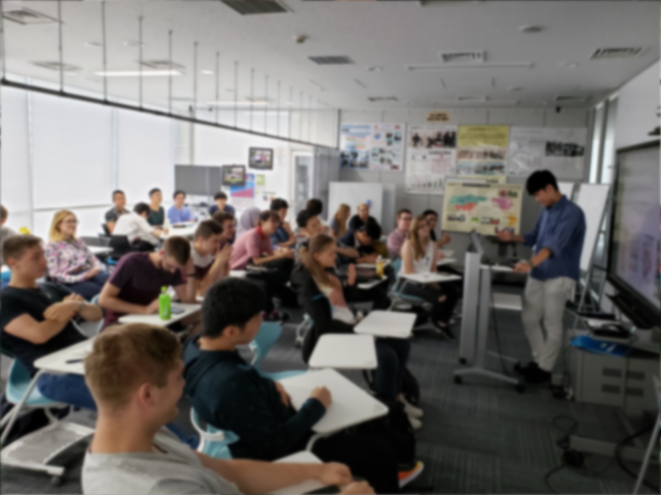

AGH & SIT Exchange Programs
AY 2004： Become Partner Universities
AY 2008：From AGH to SIT 3 Students
From SIT to AGH 2 Students
AY 2009：From AGH to SIT 4 Students
From SIT to AGH 1 Students
AY 2010：From AGH to SIT 2 Students
From SIT to AGH 2 Students
AY 2011：From AGH to SIT 4 Students
From SIT to AGH 3 Students
AY 2012：From AGH to SIT 2 Students
(incl. 1 DD student)
From SIT to AGH 2 Students
AY 2013：From AGH to SIT 4 Students
(incl. 1 DD student)
From SIT to AGH 6 Students
AY 2014：From AGH to SIT 7 Students
From SIT to AGH 17 Students
AY 2015：From AGH to SIT 23 Students
From SIT to AGH 10 Students
AY 2016：From AGH to SIT 15 Students
From SIT to AGH 14 Students
AY 2017：From AGH to SIT 12 Students
From SIT to AGH 6 Students
AY 2018：From AGH to SIT 12 Students
From SIT to AGH 11 Students
AY 2019
Global PBL: Summer School @ SIT
August 28 – September 10, 2019
11 Students and 2 Professors from AGH
Global PBL: Winter School @ AGH
February 24 – March 6, 2020
8 Students and 1 Professor from SIT
From AGH to SIT
Sandwich Program: 1 Student
Research Exchange Program: 6 Students
Joint Degree Program for master level
will start in 2022

